Slide 1



Auditing Sustainable Development Goals

Slide 2
Auditing Sustainable Development Goals
Background
  Programme Objective
  Participating SAIs and Level of participation
  Cooperation Partners
  Programme Implementation Strategy
  Expected Outputs and Outcomes
  Programme Activities
  Requirements from participating SAIs

Slide 3
Background
The Sustainable Development Goals (SDGs): an ambitious and long-term agenda on a broad range of vital issues.
The UN Members State declaration on the SDGs, “Transforming Our World: The 2030 Agenda For Sustainable Development”
Governments have the primary responsibility for follow-up and review, at the national, regional and global levels, in relation to the progress made in implementing the goals and targets over the coming fifteen years

Slide 4
Background
SAIs also have a responsibility:
They can, through their audits and consistent with their mandates and priorities, make valuable contributions to national efforts to track progress, monitor implementation and identify improvement opportunities across the full set of the SDGs.
INTOSAI has an important supporting and leveraging role to play in this regard.
This role of the INTOSAI is planned to be elaborated in INTOSAI Strategic Plan 2017-2022.
In keeping with these INTOSAI and SAI priority, the IDI has planned a pilot programme on Auditing Sustainable Development Goals (SDGs) in collaboration with INTOSAI Knowledge Sharing Committee (KSC) and other interested INTOSAI bodies.

Slide 5
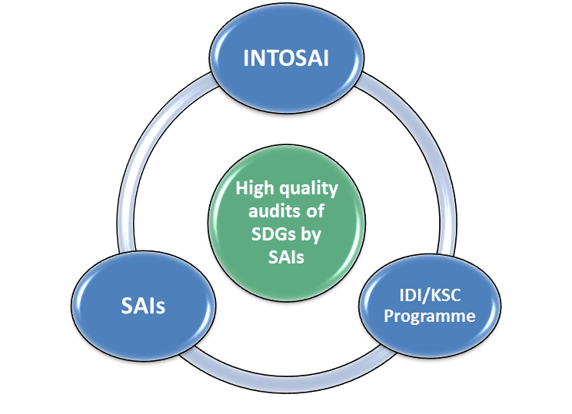
Background
Programme Objective
High quality audits of sustainable development goals by SAIs.
Cooperation Partners
INTOSAI Bodies, SAIs, INTOSAI regions, UN

Slide 6
INTOSAI, SAIs and SDGs
The INTOSAI believes that SAIs can contribute to SDGs by providing advice, through assurance engagements and by conducting performance audits and reviews. The SAIs can also contribute by leading by example in being models of transparency and accountability.
INTOSAI plans to support and encourage its member SAIs in this regard by:
  Awareness raising and advocacy
  Aggregating results of SAI work done in this area
  Providing methodological support

Slide 7
INTOSAI, SAIs and SDGs
In order to provide support to its member, INTOSAI will consider the following support processes and tools:
  Guidance and standards
  Community of practice
  Think Tank on SDGs
  Cooperative Audits
  Lessons Learned documentation
  Regular product review

Slide 8
Four Approaches to SDGs
2. Performance Audit of programmes that contribute to SDGs
3. Assessing and supporting SDG 16
1. Auditing national systems of follow-up
4. Being model of transparency and accountability

Slide 9
Approch 1.
Auditing national follow-up systems
2016
Guidance on auditing preparedness
2017-2018
ISSAI based cooperative performance audit on preparedness
2019
Lessons learned and audit results
Advocacy & Awareness Raising
Community of Practice

Slide 10
IDI-KSC Auditing SDGs Programme
As INTOSAI bodies, the IDI and KSC will support and encourage SAIs to contribute to SDGs by participating in awareness raising and advocacy.
As SDGs have been recently adopted at UN level and by all nations, this would be the right time for SAIs to ascertain the preparedness of their country level systems in keeping their national commitments.
As such this programme will provide methodological support to SAIs for conducting ISSAI based performance audit on preparedness for implementation.

Slide 11
Ensuring that no one is left behind
Policy & enabling environment
Creating ownership
Incorporating in national frameworks
Intergration of social, economic & environmental dimensions
Definition of baselines & indicators
Thematic analysis
Institutional mechanisms

Slide 12
Cooperative audit of preparedness for implementation of SDGs
As a part of this programme 40 SAIs from different INTOSAI regions will be provided blended support in conducting an ISSAI based performance audit on preparedness for implementation of SDGs.
Agree on commitments will be the critical first step. The guidance developed in 2016 will be used to train SAI teams, support and quality assure audits.
SAIs of 21 countries undergoing the HPLF reviews will be invited to participate.
Besides these, other SAIs will be invited based on the following criteria – SAI commitment, readiness at SAI and country level, ability to influence others and create impact in their environments.
The audits will be carried during 2017 and 2018.

Slide 13
Overview of the program
Workshop on subject matter and methodology
Focus on subject matter & methodology
E-facilitation of development of audit plan
Support to SAI audit teams for audit planning
Audit Review Meeting
Support for finalising audit report
Quality Assurance
Independent assurance of audit quality
SAI Commitment
Agreement with SAI leadership

Slide 14
Programme Description
Objective: High quality audits of sustainable development goals by SAIs.
Participating SAIs: This programme is planned to be offered in English in this first round. While the programme can accommodate SAI teams from 40 SAIs. It will be open for all SAIs in the INTOSAI. SAIs will be offered the programme based on commitment and first come first serve basis.
Level of Participants: Head of SAI, top management (for management meeting), middle management (functional heads), audit teams, SAI staff (audit and non audit).

Slide 15
Programme Description
Planned Cooperation Partners: United Nations, INTOSAI Knowledge Sharing Committee, INTOSAI Capacity Building Committee, INTOSAI Professional Standards Committee, INTOSAI Regions.

Slide 16
Programme Description
The programme envisages achieving its objective by implementing the following results framework:
Community of Practice on Auditing Sustainable Development Goals –
The IDI will cooperate with INTOSAI KSC to set up a web based community of practice (CoP) on auditing SDGs.
The CoP will provide a platform for information, experience & knowledge sharing and capacity development support related to auditing SDGs.
The CoP is expected to be inaugurated by end of 2016.
CoP
Auditing Implementation of SDGs

Slide 17
Programme Description
SAIs: most SAIs in the INTOSAI community already conduct audits on topics covered by SDGs.
SAIs could be encouraged to map their current audit portfolio under the different SDGs to check the extent to which these topics are already covered.
CoP
Auditing Implementation of SDGs

Slide 18
Programme Description
GPG
Guidance Auditing Preparedness for Implementation
Guidance for Auditing Preparedness for implementation of SDGs –
In order to implement these ambitious goals, various governments will need to identify their priorities, systems and procedures for implementation and more importantly system of gathering performance data on implementation of SDGs.
The IDI and KSC will put together an international team of resource persons to research and write guidance on how to conduct an audit of the preparedness of governments for implementation of SDGs.
A draft of this document will be made available for discussion and feedback during discussions on theme 2 at INCOSAI 2016. This guidance will be developed in English and translated to Arabic, French and Spanish.

Slide 19
Programme Description
GPG
Guidance Auditing Preparedness for Implementation
Cooperative Audit of Preparedness of Implementation of SDGs –
The IDI will support about 40 SAIs in conducting an ISSAI based audit on preparedness for implementation of SDGs.
This will involve :
  management discussions on SDGs,
  SAI management commitment to conducting the audits,
  issuing reports and auditing SDGs on a regular basis.

Slide 20
Programme Description
GPG
Guidance Auditing Preparedness for Implementation
Cooperative Audit of Preparedness of Implementation of SDGs –
During the audits the IDI will provide:
  support by training SAI teams,
  facilitating audit planning and audit review meetings and
  providing online support to SAIs.
Following its cooperative audit model the audits conducted through this programme will also be subject to quality assurance review to ascertain the extent of compliance with ISSAIs.

Slide 21
Programme Description
Lessons Learned and Compendium of Audit findings –
The IDI will work together with KSC to document lessons learned as a part of this pilot exercise.
The IDI will also work to develop a compendium of audit findings based on the cooperative audits facilitated as a part of this programme. The compendium will be published on the community of practice.
Lessons Learned and Compendium of Audit findings

Slide 22
Programme Timeframe
2016
Research & Development of Guidance on audit of preparedness for implementation of SDGs
2015
Set up CoP for Auditing Implementation of SDGs
2019
Lessons learned and Compendium of audit findings
2017 - 2018
Blended support for Cooperative audit of preparedness for implementation of SDGs

Slide 23
Expected Outputs and Outcomes
Outputs
Community of Practice on auditing SDGs available on KSC - IDI Portal
Guidance on auditing preparedness for implementation of SDGs developed and available in english, arabic, spanish and french
Blended learning programme on auditing preparedness for implementation of SDGs
SAI teams supported in auditing preparedness for implementation
Quality assurance for published audits

Slide 24
Expected Outputs and Outcomes
Outcomes
Vibrant community of practice for auditing sustainable development goals
SAIs conduct audits of preparedness for implementation of SDGs and issue reports in accordance with ISSAIs
SAIs use trained people and guidance for conducting audit of SDGS on a regular basis

Slide 25


Programme Activities
Community of Practice (CoP)
The launching of the CoP is planned to happen in 2016. SAIs will be encouraged to share information, experience and knowledge regarding auditing SDGs and their current portfolio under the different SDGs.

Slide 26


Programme Activities
Cooperation meeting with key stakeholders
Since the first quarter of 2016, key stakeholders and partners of the programme come together to agree on programme implementation details and roles and responsibilities.

Slide 27


Programme Activities
Research on SDGs and implementation plans in different countries
The IDI set up a research team in March 2016 to ascertain the work done in their areas or planned to be done by countries and SAIs. This research will feed into the development of guidance on auditing.

Slide 28


Programme Activities
Lessons learned and compendium of audit findings
Lessons learned during this pilot phase will be documented to inform future support in this area. Compendium of audit findings will also be published based on the reports issued by SAIs.

Slide 29
Overview of the program
Workshop on subject matter and methodology
Focus on subject matter & methodology
E-facilitation of development of audit plan
Support to SAI audit teams for audit planning
Audit Review Meeting
Support for finalising audit report
Quality Assurance
Independent assurance of audit quality
SAI Commitment
Agreement with SAI leadership

Slide 30
Expectations from participating SAIs
SAIs provide In kind contribution by providing resource persons, translations support and hosting support for the programme activities.
SAIs include this audit in the SAI’s audit plan.
SAIs nominate the team conducting the audit to the programme and provide sufficient resources, time and internet access for participating in the training and for conducting the audit.
SAIs issue audit reports as per the mandate of the SAI and Include auditing SDGs in the regular audit portfolio of the SAI, so that they are carried out on regular basis.
SAIs participate in the quality assurance process.
SAIs share lessons learned and successes with other SAIs.

Slide 31

Thank you !

